Slide 1
Intro to NNs
Material from Andrew Trask’s “Grokking Deep Learning”

Slide 2
Materials
Grokking Deep Learning - Trask

Slide 3
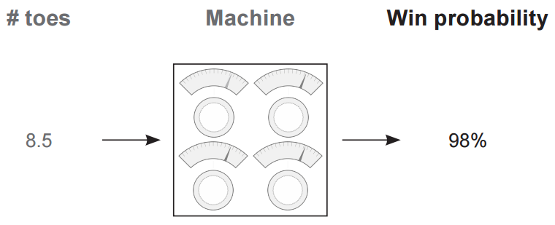
NNs are blackbox methods

Slide 4
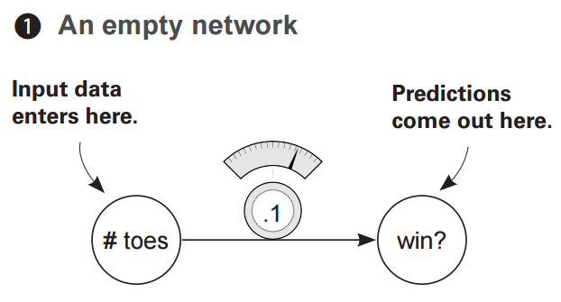
NNs are blackbox methods

Slide 5
Single input, single output
This is the simplest model possible… note that there isn’t any updating in any of the immediate examples… just feed-forward network.

Slide 6
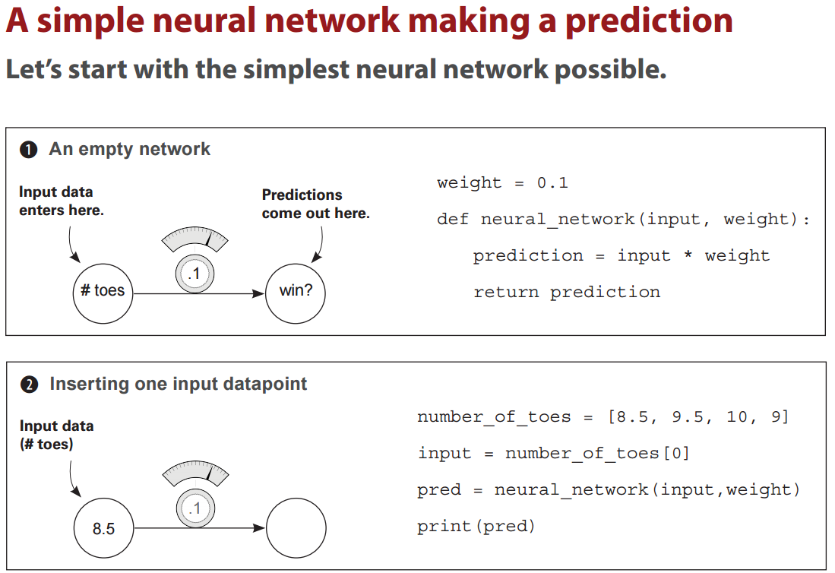

Slide 7
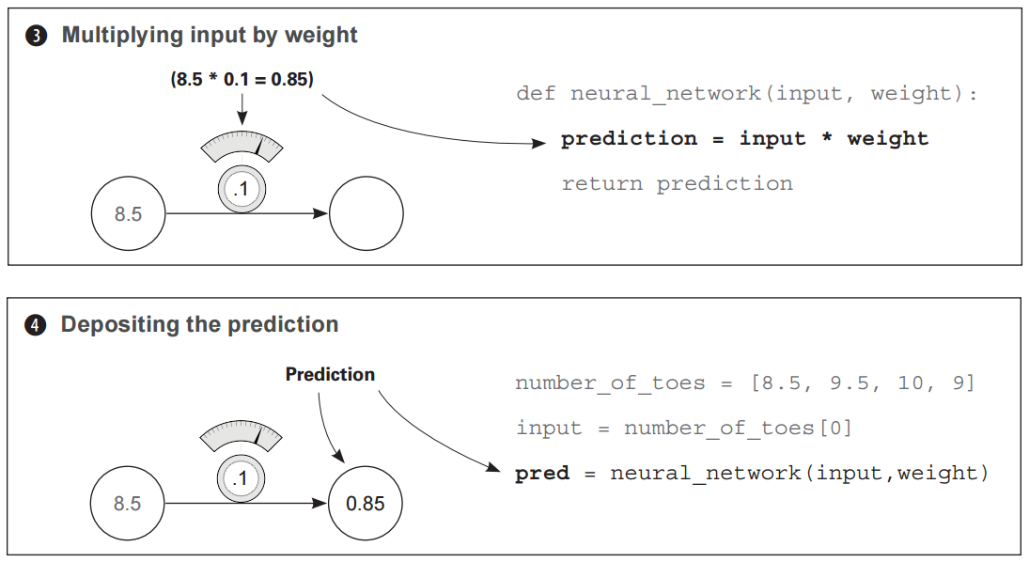

Slide 8
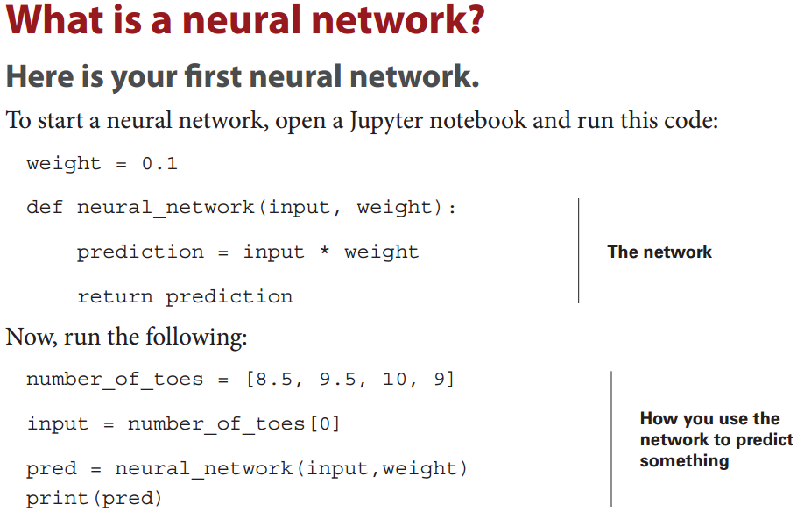

Slide 9
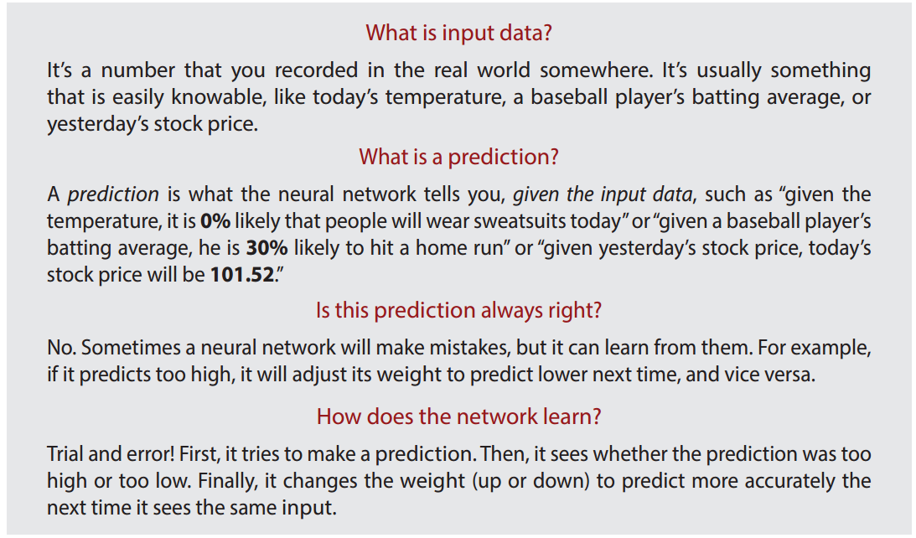
Key concepts

Slide 10
So what does a NN do?
It multiplies the input by a weight. It "scales" the input by a certain amount.

Slide 11
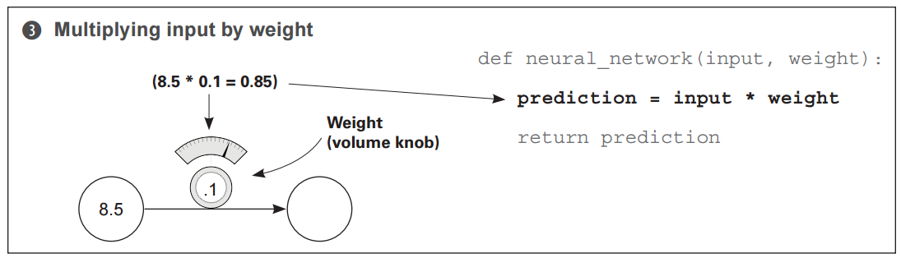
The utility of weights
If the weight is 2, then it would double our input. If the weight is 0.01, then it would divide the input by 100. As you can see, some weight values make the input bigger and other values make it smaller.

Slide 12
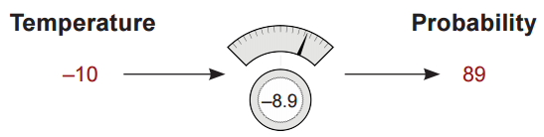
A note on input values
Neural networks don't just predict positive numbers either, they can also predict negative numbers, and even take negative numbers as input. Perhaps you want to predict the "probability that people will wear coats today", if the temperature was -10 degrees Celsius, then a negative weight would predict a high probability that people would wear coats today.

Slide 13
Multiple inputs, single output
Of course, we would hope that a NN would be able to combine info from multiple sources… and it can!

Slide 14
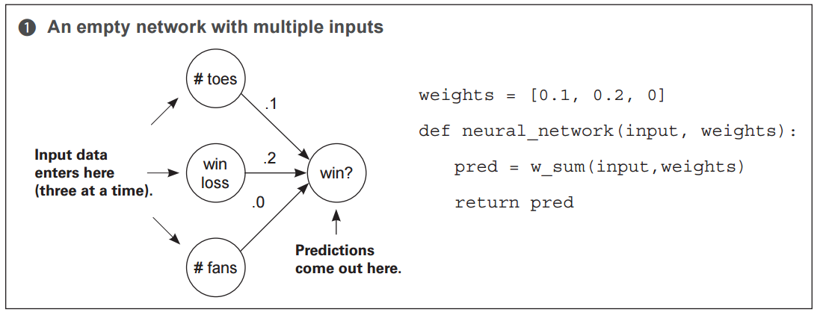

Slide 15
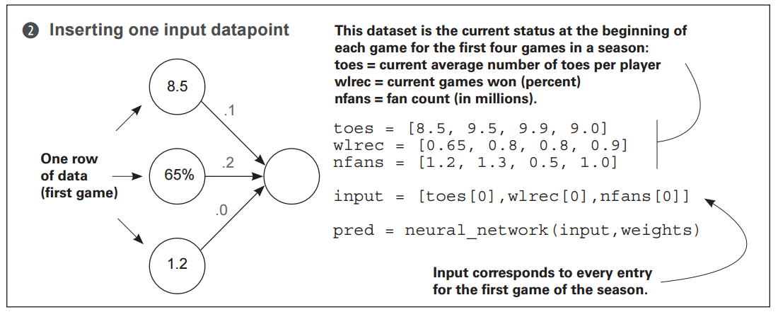

Slide 16
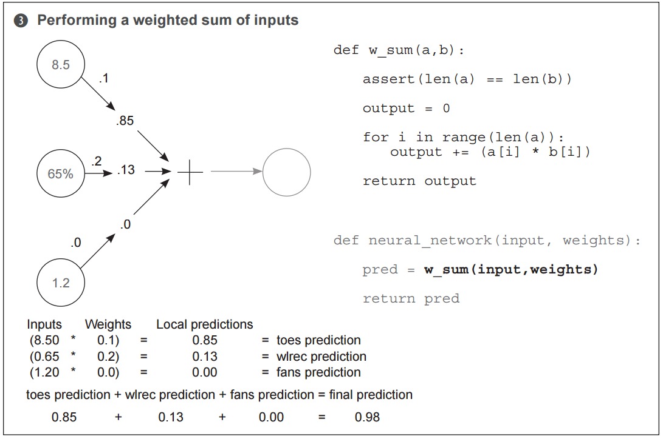

Slide 17
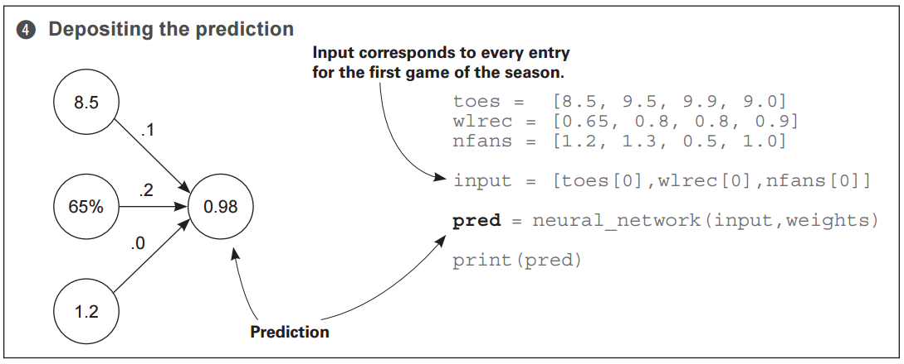
This NN multiplies 3 inputs by 3 knob weights and sums them. This is a "weighted sum“. The interface for our neural network is quite simple. It accepts an input variable as information, and a weight variable as knowledge and outputs a prediction.

Slide 18
Comments
This new neural network can accept multiple inputs at a time per prediction. This allows the network to combine various forms of information to make better-informed decisions. But the fundamental mechanism for using weights hasn’t changed. You still take each input and run it through its own volume knob.
In other words, you multiply each input by its own weight.
The new property here is that, because you have multiple inputs, you have to sum their respective predictions. Thus, you multiply each input by its respective weight and then sum all the local predictions together. This is called a weighted sum of the input, or a weighted sum for short. Some also refer to the weighted sum as a dot product.

Slide 19
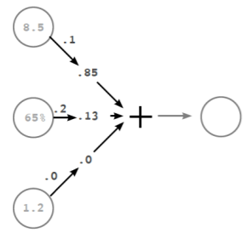
Vectors and dot products
[1,3].[3,1] = [1,1]
Vectors are incredibly useful whenever you want to perform operations involving groups of numbers. In this case, we're performing a weighted sum between two vectors (dot product). We're taking two vectors of equal length (input and weights), multiplying each number based on its position (the first position in input is multiplied by the first position in weights, etc.), and then summing the resulting output.
0.98
A1*b1 + a2*b2 + a3*b3 = c

Slide 20
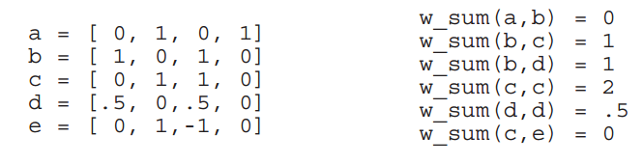
Weighted sums (dot products)
The intuition behind how and why a dot product (weighted sum) works is easily one of the most important parts of truly understanding how neural networks make predictions. Loosely stated, a dot product gives us a notion of similarity between two vectors. Consider the examples:
The highest weighted sum (w_sum(c,c)) is between vectors that are exactly identical. In contrast, since a and b have no overlapping weight, their dot product is zero. Perhaps the most interesting weighted sum is between c and e, since e has a negative weight. This negative weight cancelled out the positive similarity between them. However, a dot product between e and itself would yield the number 2, despite the negative weight (double negative turns positive).

Slide 21
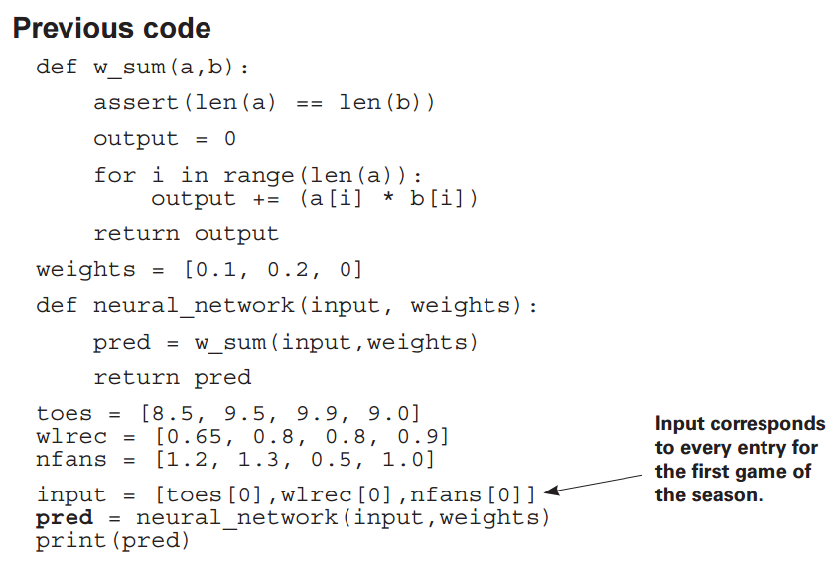
NNs from scratch (with code)

Slide 22
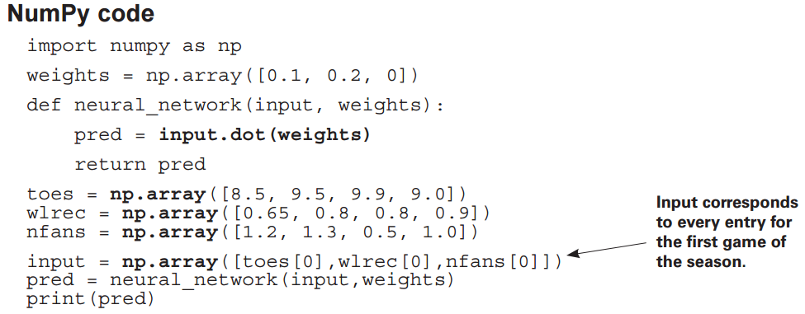
NNs from scratch (with code)

Slide 23
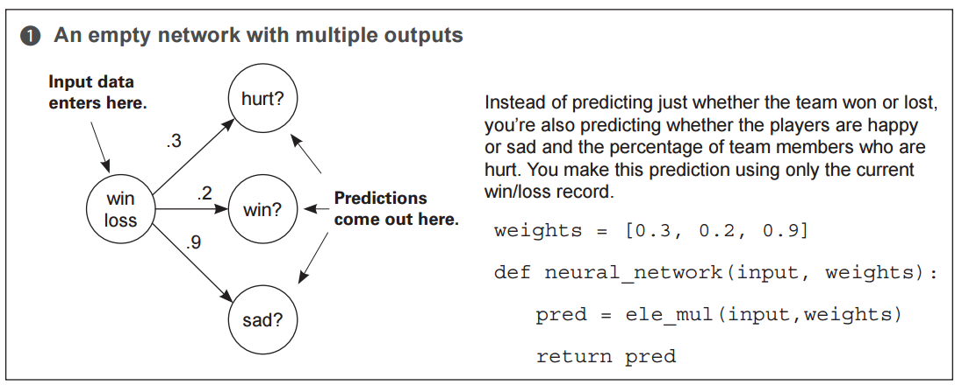
Single input, multi output

Slide 24
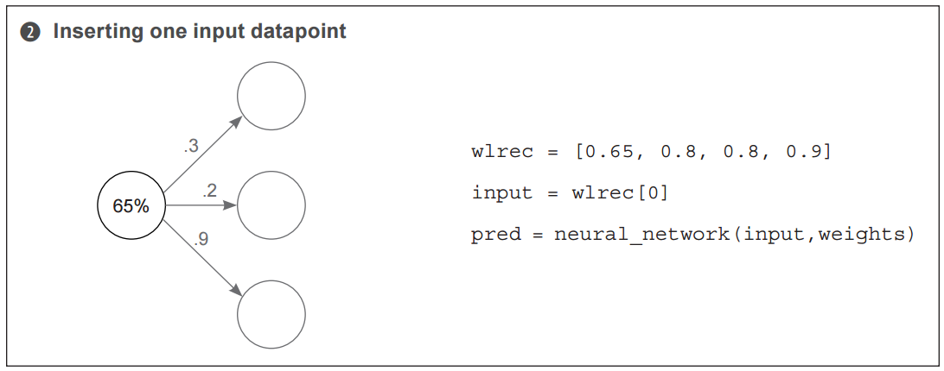
The most important commentary in this setting is to notice that the 3 predictions really are completely separate. Unlike neural networks with multiple inputs and a single output where the prediction is undeniably connected this network truly behaves as 3 independent components, each receiving the same input data.

Slide 25
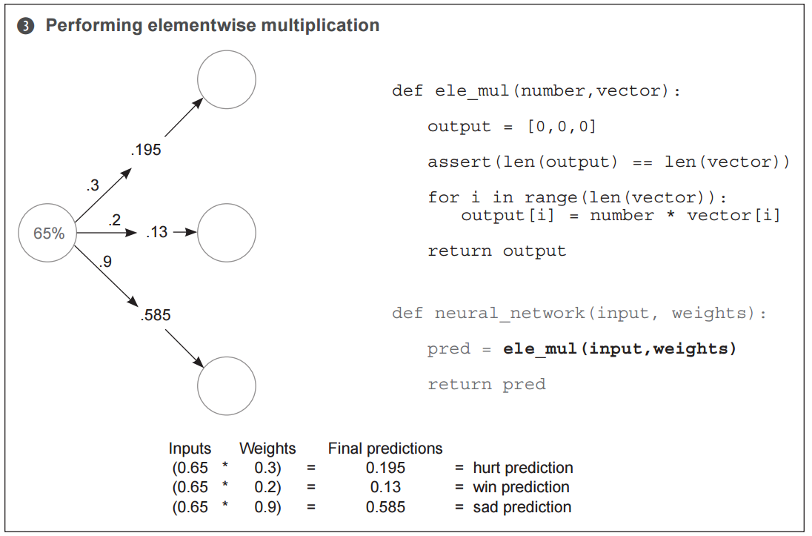

Slide 26
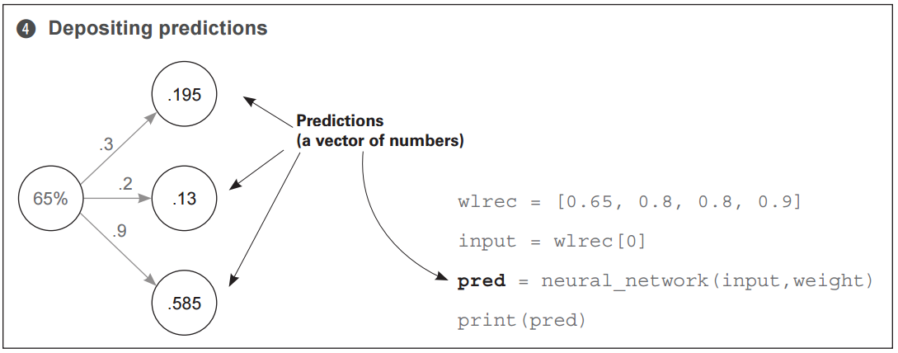

Slide 27
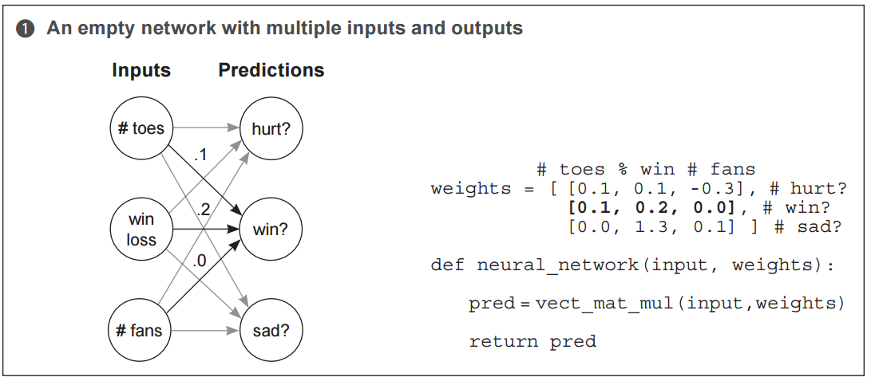
Multiple inputs, multiple outputs
“The golden rule of dot products”
Just like before, we simply have a weight connecting each input node to each output node and prediction occurs in the usual way.

Slide 28
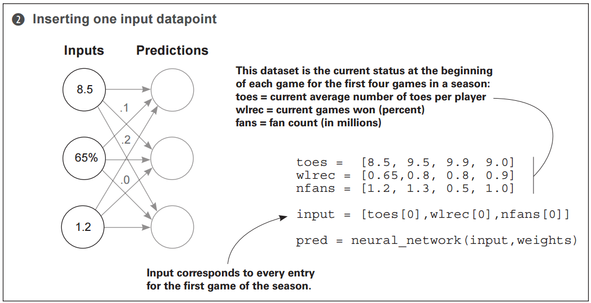

Slide 29
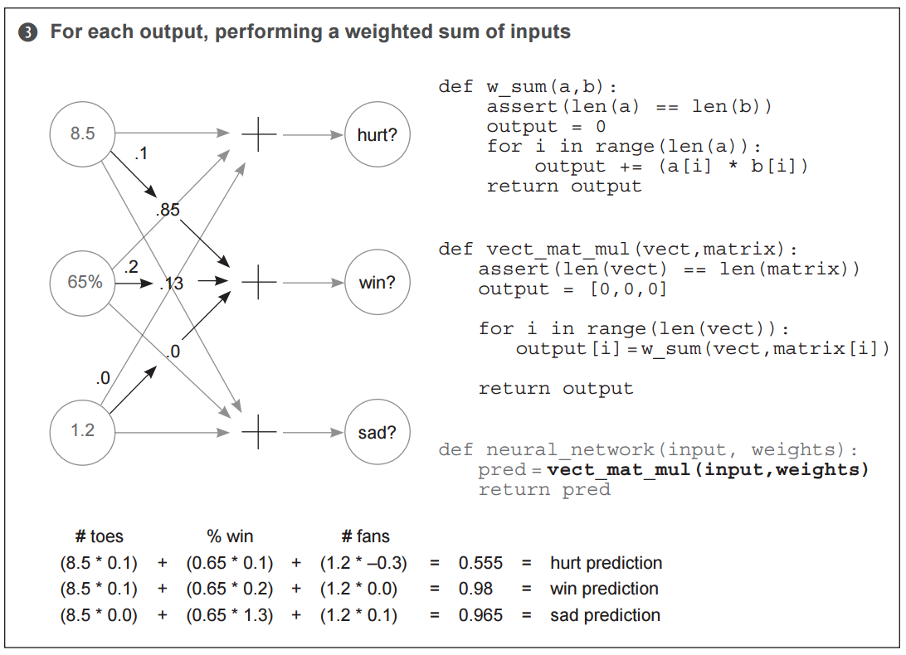

Slide 30
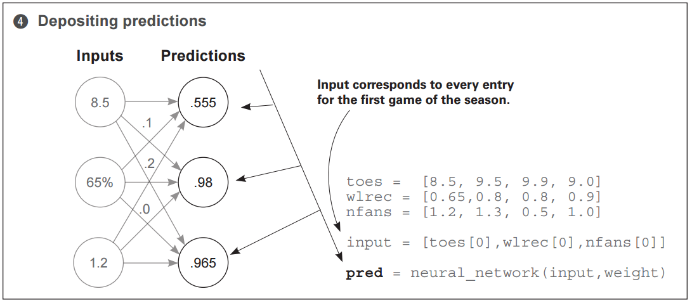

Slide 31
Can neural networks have more than one hidden layer of weights?
YES!

Slide 32
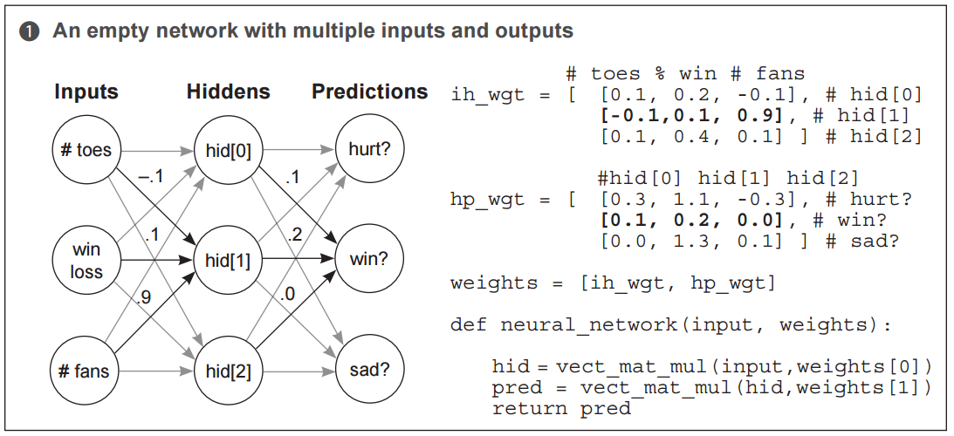
Neural networks can be stacked!
Careful - this changes a bit in later examples…. [1,3] input data and a [3,5] weights gives a [1,5] hidden layer...
Now we have a weight matrix vs. vector…

Slide 33
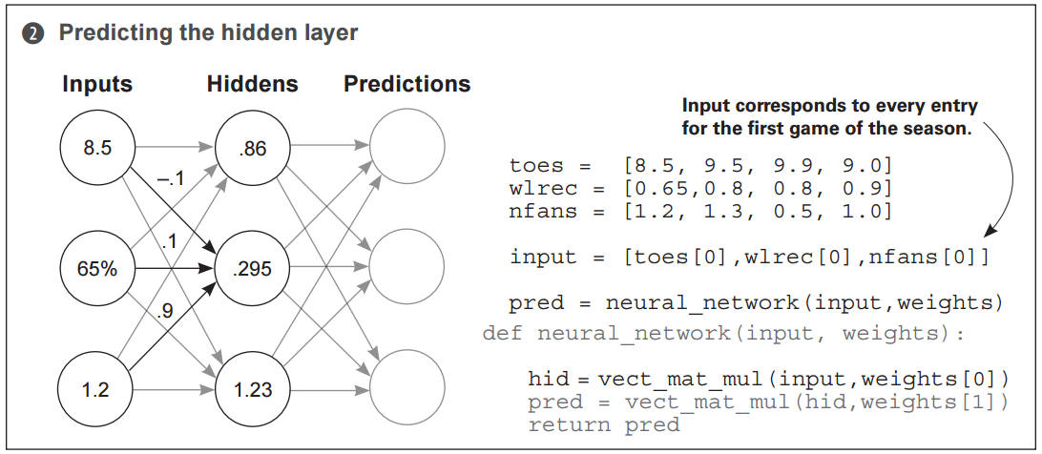
Keep repeating the dot product...

Slide 34
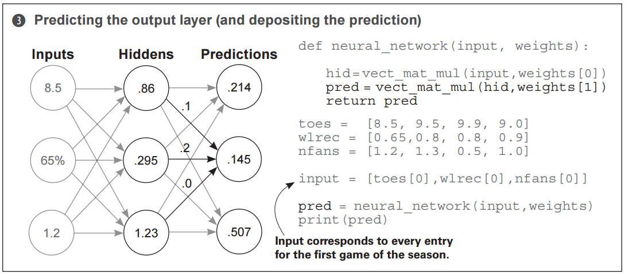
How many weights are there?

Slide 35
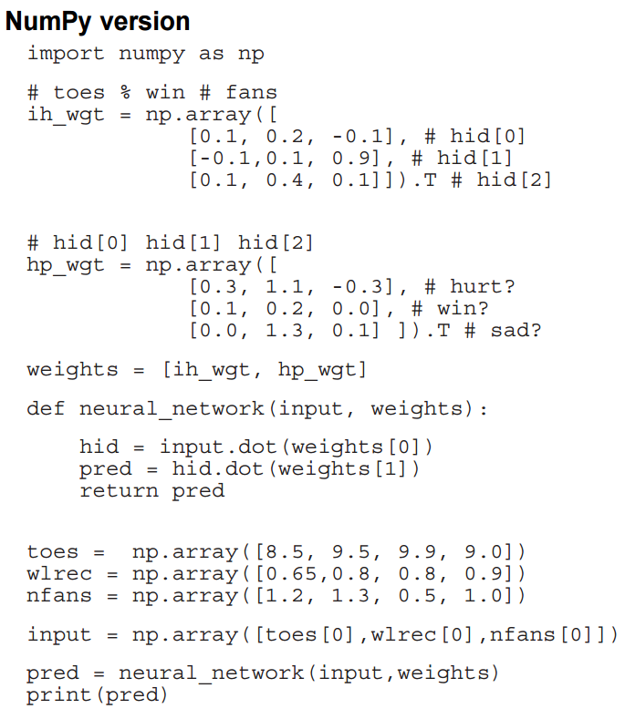

Slide 36
Main Ideas
To predict, neural networks perform repeated weighted sums of the input. You have seen this hold true for multiple architectures!
Everything we have done in this chapter is a form of what's called Forward Propagation, wherein a neural network takes input data and makes a prediction. It is called this because we are propagating activations forward through the network.

Slide 37
This ends our section on forward propagation… now what?
Onto backpropagation! We need a way to evaluate our models.

Slide 38
Towards Gradient Descent
Three fundamental steps to fitting a NN:
Predict (which we’ve covered a lot so far)
Compare (what was error between actual and predicted)
Learn (update the weights to make a more accurate prediction)

Slide 39
Compare
A measurement of how much our prediction “missed”.
Once we've made a prediction, the next step to learn is to evaluate how well we did.
There are many properties of "measuring error" that you have likely been doing your whole life without realizing it. Perhaps you (or someone you know) amplifies bigger errors while ignoring very small ones.

Slide 40
Learn
"Learning" takes our error and tells each weight how it can change to reduce it.
Learning is all about "error attribution", or the art of figuring out how each weight played its part in creating error. It's the "blame game" of neural networks – more officially, it’s called “gradient descent”. At the end of the day, it's going to result in computing a number for each of our weights. That number will represent how that weight should be higher or lower in order to reduce the error. Then we will move the weight according to that number, and we'll be done.

Slide 41
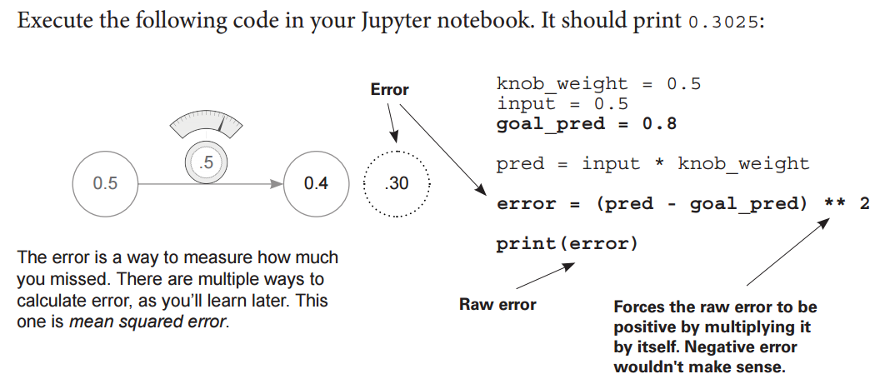
So, does our network make good predictions?
Typo in the book!!!
p.46
ERROR IS SQUARED ERROR!!!
0.25
0.55

Slide 42
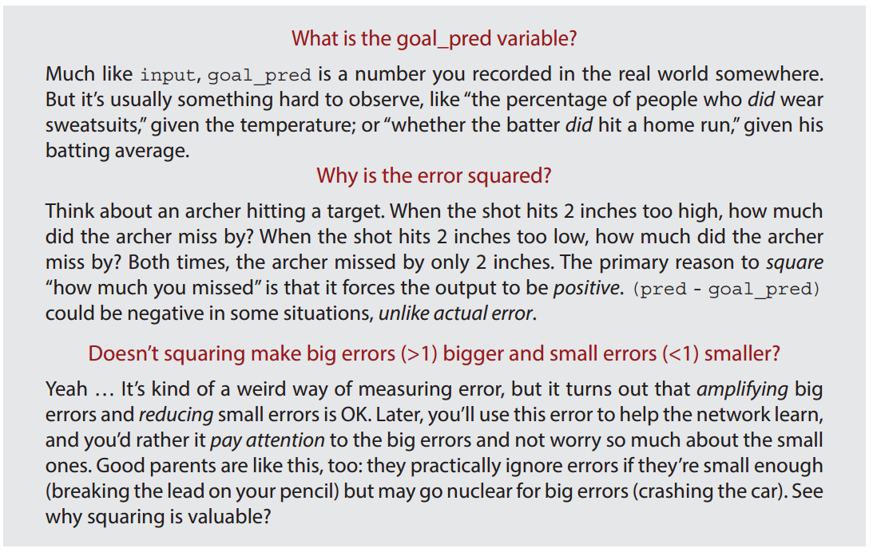
Key concepts

Slide 43
Why measure error?
The goal of training our neural network is to make correct predictions. Measuring error simplifies this challenge. It’s the signal we will use to update the weights.

Slide 44
Hot and cold learning
To demonstrate how error is a signal to learn on, let’s look at a manual example (similar to raising or lowering the temperature.)
We wiggle our weights to see which direction reduces the error the most, moving our weights in that direction, and repeating until the error gets to 0.

Slide 45
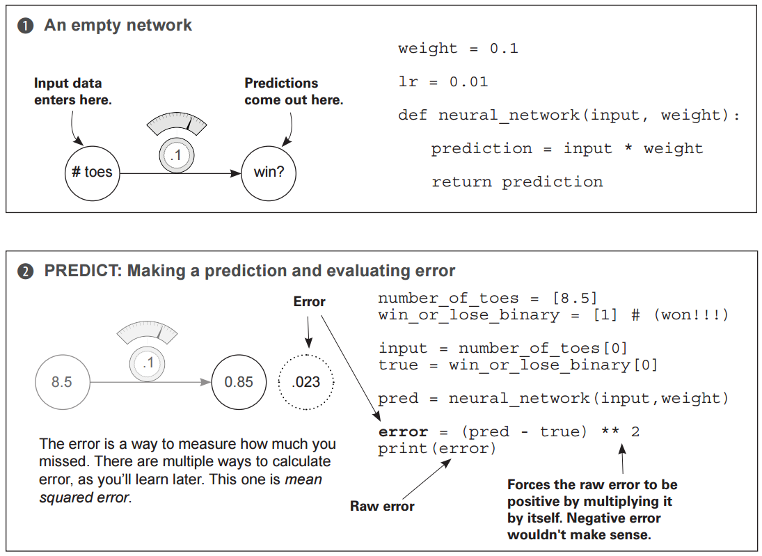

Slide 46
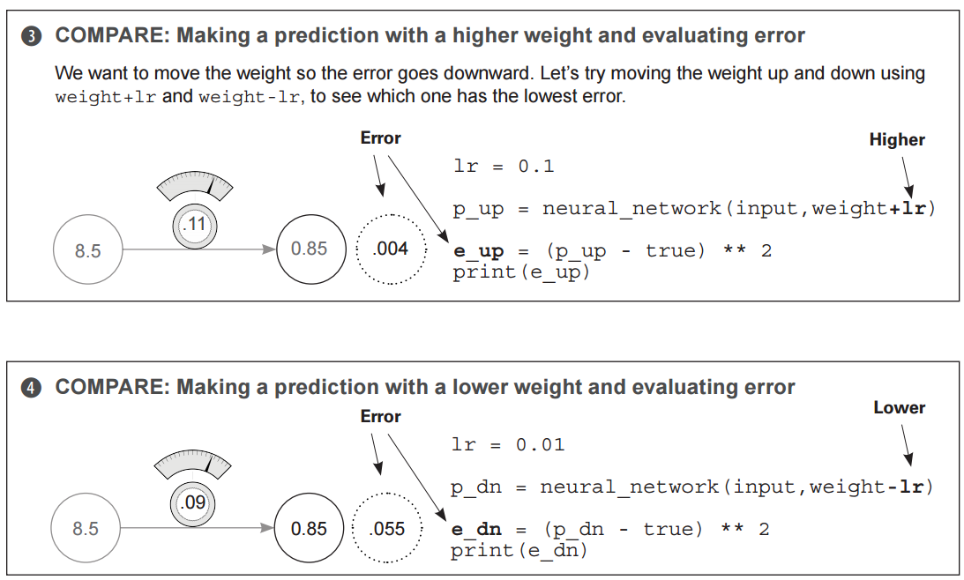

Slide 47
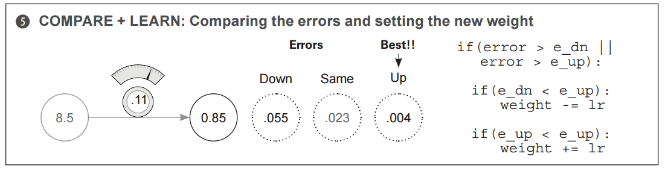
Now, evaluate and make tweaks.

Slide 48
Some thoughts on hot and cold learning…
Fortunately, this iteration got us pretty close to the correct answer all by itself (the new error is only 0.004). However, under normal circumstances, we would have to repeat this process many times in order to find the correct weights.
Some people even have to train their networks for weeks or months before they find a good enough weight configuration.
This reveals what learning in neural networks really is. It's a search problem. We are searching for the best possible configuration of weights so that our network's error falls to zero (and predicts perfectly).

Slide 49
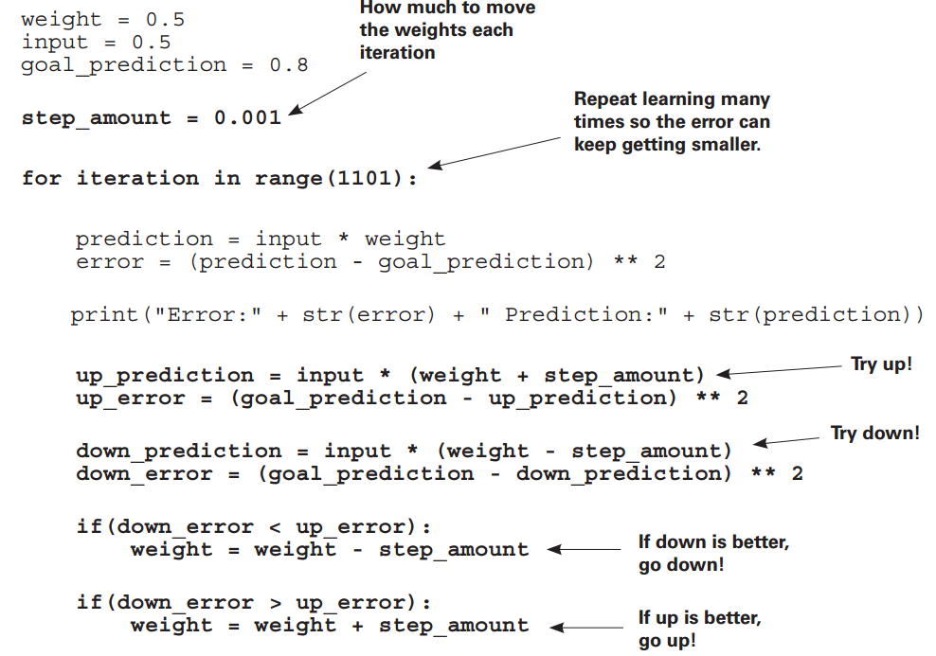
A code example with iterations

Slide 50
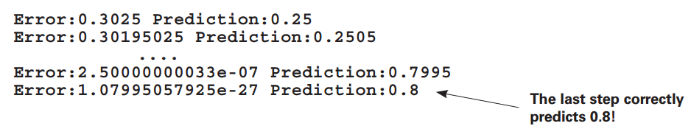
Output
Some problems:
This is clearly inefficient. Specified exactly 1101 times to iterate over (why?)
Sometimes, it’s impossible to predict the exact goal prediction. We may iterate indefinitely without some stopping criteria!
The real problem here is that even though we know the correct direction to move our weight, we don't know the correct amount. Since we don't know the correct amount, we just pick a fixed one at random (step_amount).

Slide 51
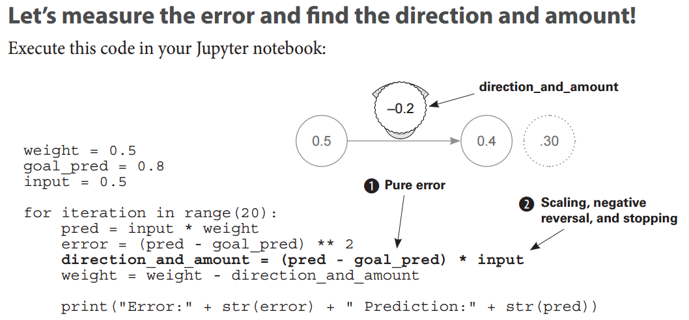
Error: Direction and Amount
Typo in the book!
We can workout by hand
p. 56
THIS IS GRADIENT DESCENT!
-0.275
0.25
0.3025

Slide 52
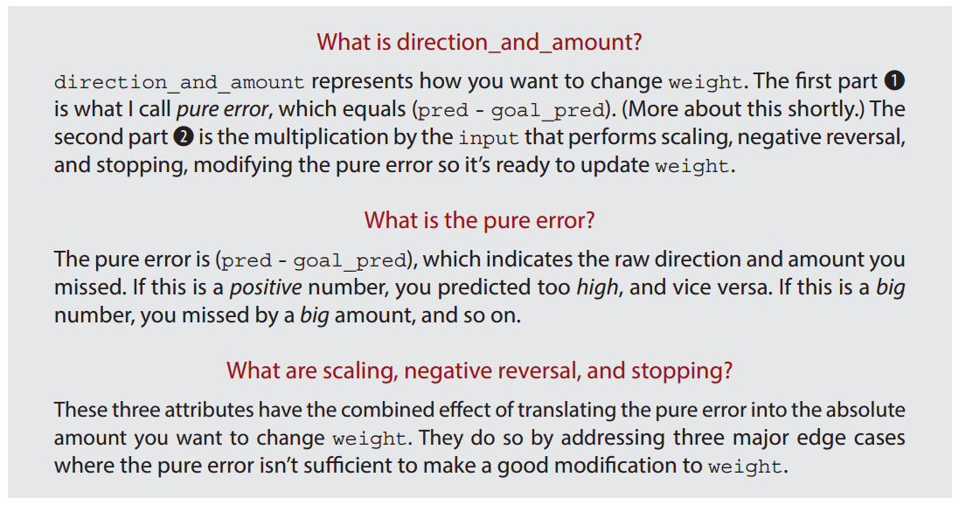
Key concepts

Slide 53
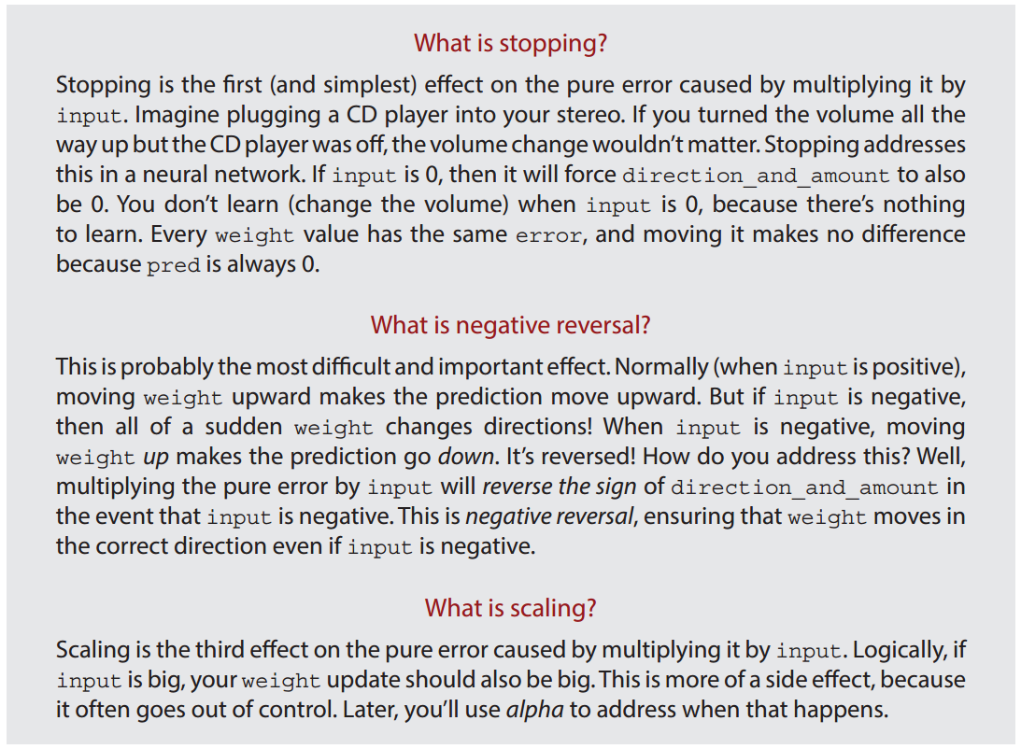
Key Concepts

Slide 54
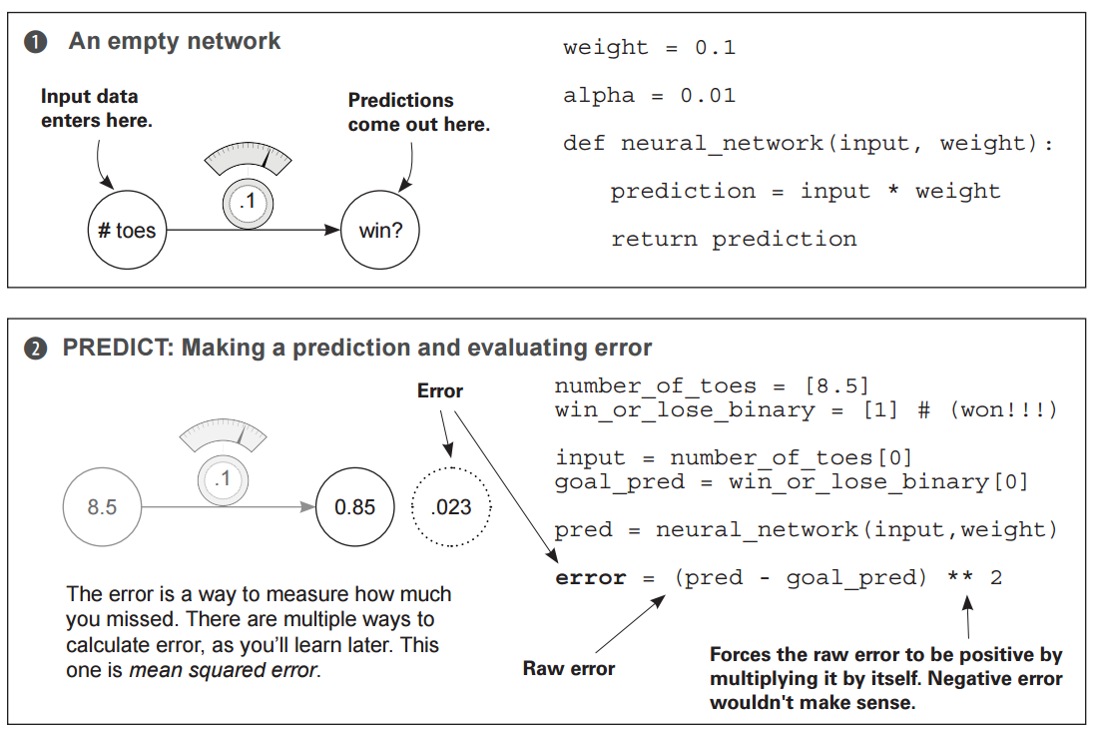
One iteration of gradient descent

Slide 55
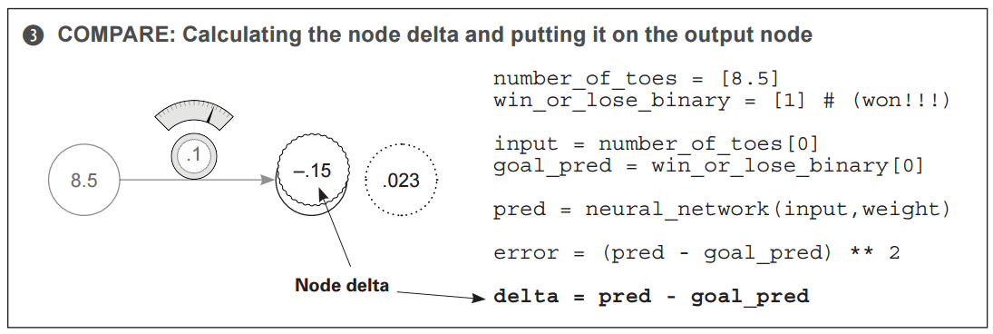
Delta can be thought of as “pure error.” It is direction and amount.

Slide 56
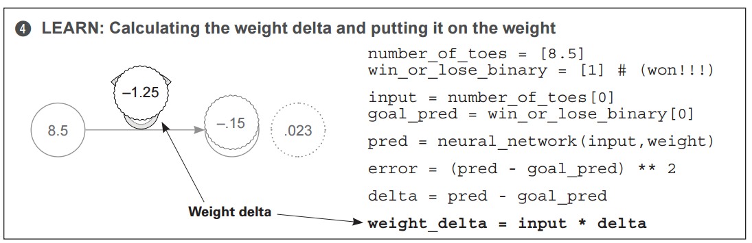

Slide 57
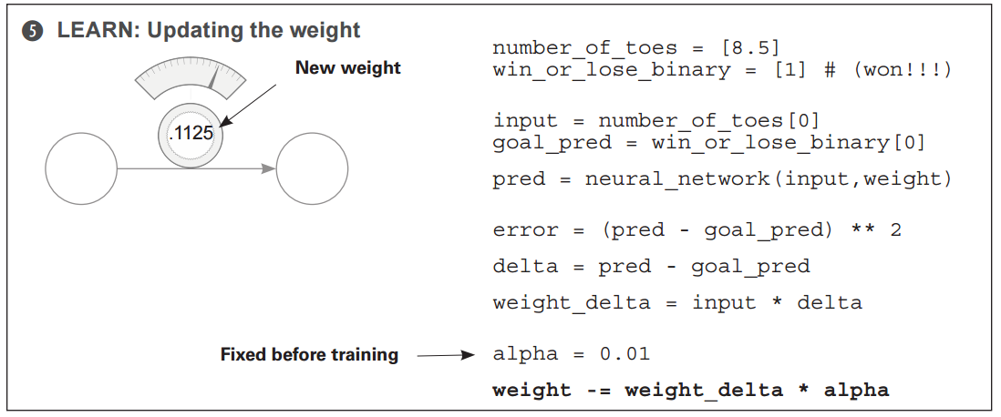

Slide 58
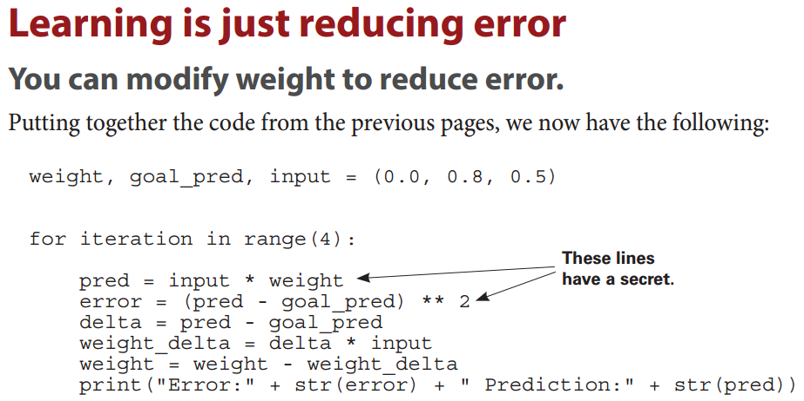
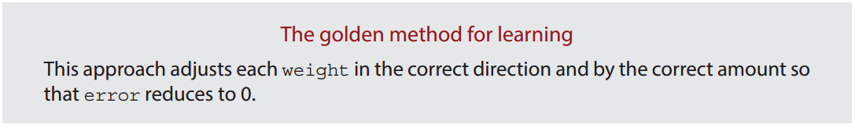
Memorize this!
PEDW

Slide 59
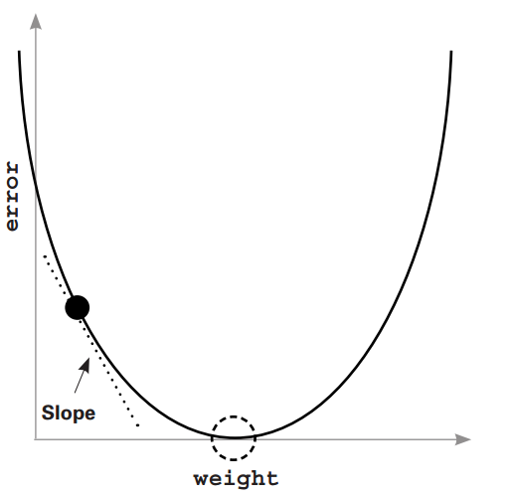
Why do we need negative reversal?
This graph represents every value of error for every weight according to the relationship in the formula above. Notice it makes a nice bowl shape. The black "dot" is at the point of BOTH our current weight and error. The dotted "circle" is where we want to be (error == 0).
The slope points to the bottom of the bowl (lowest error) no matter where you are in the bowl. You can use this slope to help the neural network reduce the error.

Slide 60
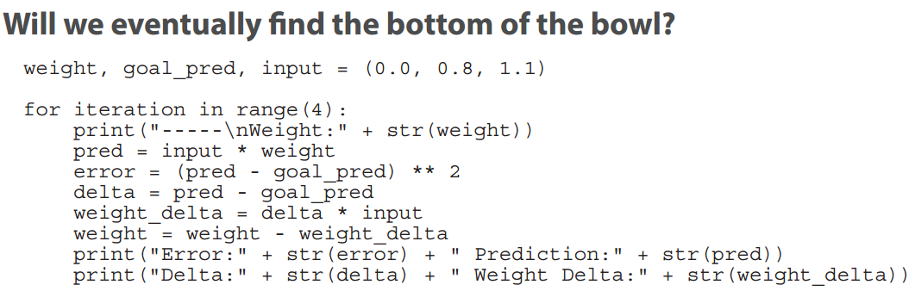
Let’s watch some steps of learning

Slide 61
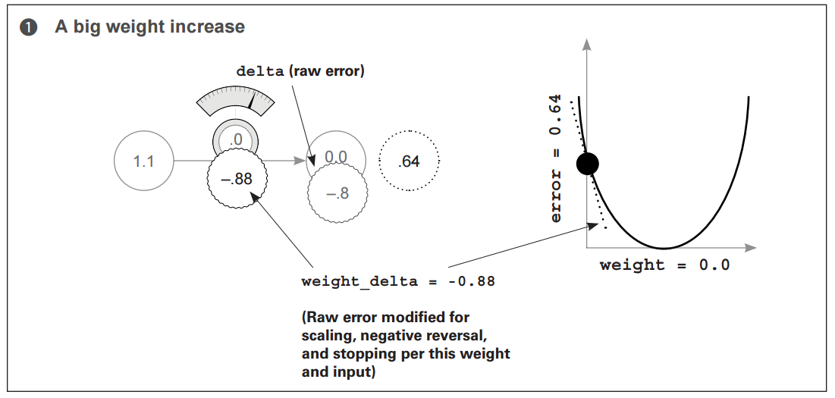
WEIGHT DELTA IS THE SLOPE!
SWITCH THE DIRECTION!
weightdelta = delta*input

Slide 62
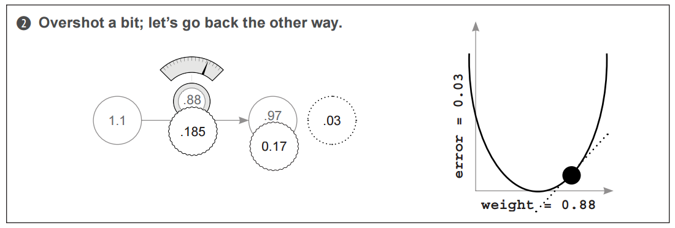
WEIGHT DELTA IS THE SLOPE!
SWITCH THE DIRECTION!
weightdelta = delta*input

Slide 63
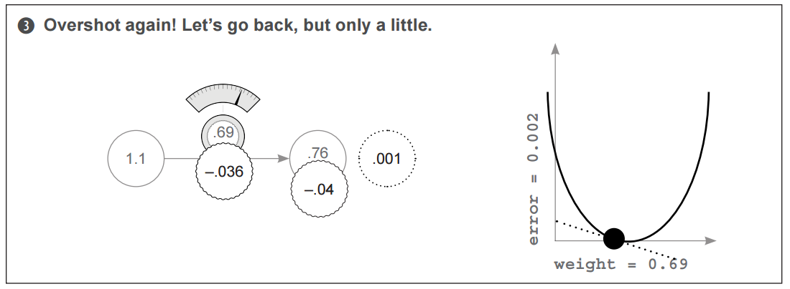
WEIGHT DELTA IS THE SLOPE!
SWITCH THE DIRECTION!
weightdelta = delta*input

Slide 64
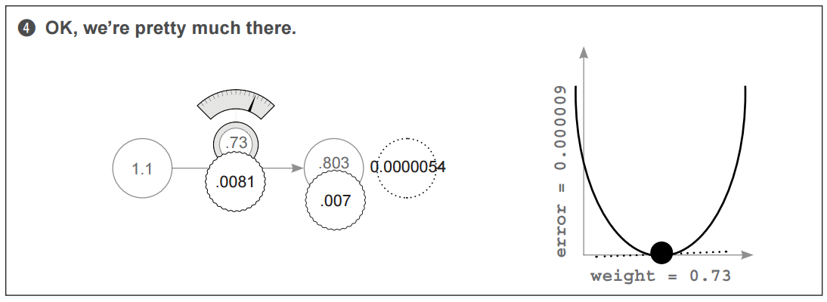
WEIGHT DELTA IS THE SLOPE!
SWITCH THE DIRECTION!
weightdelta = delta*input

Slide 65


Slide 66

Why does this work?
"Learning is adjusting our weight to reduce the error to zero"

Slide 67

Terminology: weight delta is a “derivative” (slope).
There are two ways I've heard people explain derivatives. One way is all about understanding "how one variable in a function changes when you move another variable". The other way of explaining it is "a derivative is the slope at a point on a line or curve".
As it turns out, if you take a function and plot it out (draw it), the slope of the line you plot is the same thing as "how much one variable changes when you change the other".
A derivative is a slope! With derivatives... we can pick any two variables... in any formula... and know how they interact.

Slide 68
Weight delta is our derivative!
The slope of a line or curve always points in the opposite direction to the lowest point of the line or curve. So, if you have a negative slope, you increase your weight to find the minimum of the error. So, how do we use our derivative to find the error minimum (lowest point in the error graph)?
We just move the opposite direction of the slope!
We move in the opposite direction of the derivative!
So, we can take each weight, calculate the derivative of that weight with respect to the error (so we're comparing two variables there... the weight and the error) and then change the weight in the opposite direction of that slope! That will move us to the minimum!

Slide 69
Revisiting our goal
We are trying to figure out the direction and the amount to change our weight so that our error goes down.
A derivative gives us the relationship between any two variables in a function.
We use the derivative to determine the relationship between any weight and the error.
We then move our weight in the opposite direction of the derivative to find the lowest weight.
This method for learning (finding error minimums) is called Gradient Descent. This name should seem intuitive! We move in the weight value opposite the gradient value, which descends our error to 0. By opposite, I simply mean that we increase our weight when we have a negative gradient and vice versa. It's like gravity!

Slide 70

Breaking gradient descent with over corrections

Slide 71


Slide 72


Slide 73

Divergence = breaking gradient descent

Slide 74
How can we prevent divergence?
The solution is to multiply the weight update by a fraction to make it smaller. In most cases, this involves multiplying our weight update by a single real-valued number between 0 and 1, known as alpha.
Finding the appropriate alpha, even for state-of-the-art neural networks, is often done simply by guessing. You watch your error over time.
If it starts diverging (going up), then your alpha is too high, and you decrease it.
If learning is happening too slowly, then your alpha is too low, and you increase it.

Slide 75

Alpha in the code
Notice we only needed 20 iterations vs 1001 before…

Slide 76
Gradient descent applied to our previous examples
Now we will more or less reveal how the same techniques can be used to update a network that contains multiple weights.

Slide 77


Slide 78


Slide 79


Slide 80


Slide 81

Let’s watch some stages of learning.

Slide 82

Let’s watch some iterations of learning.

Slide 83

Let’s watch some iterations of learning.

Slide 84

Let’s freeze a weight!

Slide 85

What happens when you freeze a weight?

Slide 86


Watch learning while weight[0] is frozen.

Slide 87
What did we see?
Perhaps you will be surprised to see that (a) still finds the bottom of the bowl? Why is this?
Well, the curves are a measure of each individual weight relative to the global error. Thus, since the error is shared, when one weight finds the bottom of the bowl, all the weights find the bottom of the bowl.

Slide 88
A powerful lesson.
This is actually an extremely important lesson. First of all, if we converged (reached error = 0) with (b) and (c) weights and then tried to train (a), (a) wouldn't move! Why? error = 0 which means weight_delta is 0!
This reveals a potentially damaging property of neural networks. (a) might be a really powerful input with lots of predictive power, but if the network accidentally figures how to predict accurately on the training data without it, then it will never learn to incorporate (a) into its prediction.

Slide 89

GD: Single input, multi-outputs

Slide 90


Slide 91


Slide 92


Slide 93

GD: Multiple Inputs and Outputs

Slide 94


Slide 95


Slide 96


Slide 97


Application to MNIST

Slide 98

Visualizing the Weights
If the weight is high, it means the model believes there’s a high degree of correlation between that pixel and the number 2. If the number is very low (negative), then the network believes there is a very low correlation (perhaps even negative correlation) between that pixel and the number 2. If you take the weights and print them out into an image that’s the same shape as the input dataset images, you can see which pixels have the highest correlation with a particular output node. In our example, a very vague 2 and 1 appear in the two images, which were created using the weights for 2 and 1, respectively. The bright areas are high weights, and the dark areas are negative weights. The neutral color (red, if you’re reading this in the eBook) represents 0 in the weight matrix. This illustrates that the network generally knows the shape of a 2 and of a 1.

Slide 99

It all ties back to the dot product!

Slide 100

It all ties back to the dot product!

Slide 101
Intro to NNs (Part 2)
Dave Wanik
Material from Andrew Trask’s “Grokking Deep Learning”

Slide 102

Let’s learn an entire dataset (streetlights).

Slide 103

Recoding into useful information

Slide 104

Can be integer or decimals… doesn’t matter!

Slide 105

Can be integer or decimals… doesn’t matter!

Slide 106

Our blackbox example.

Slide 107

Recoding Data: Input Features

Slide 108

Recoding Data: Target Variable

Slide 109

Building our network

Slide 110

Numpy is our saving grace…
Numpy matrices can perform element-wise addition and multiplication.
When you put a "+" sign between two vectors, it does what you would expect it to. It adds the two vectors together.
Other than these nice numpy operators and our new dataset, the neural network above is the same as ones we built before

Slide 111


How can we learn the whole dataset?
Nested for loops
We train on the entire dataset at once!

Slide 112
The various types of gradient descent
Stochastic
Learning "one example at a time" is a variant on Gradient Descent called Stochastic Gradient Descent, and it is one of the handful of methods that can be used for learning an entire dataset.
Full
Instead of updating the weights once for each training example, the network simply calculates the average weight_delta over the entire dataset, only actual y changing the weights each time it computes a full average.
Batch
Instead of updating the weights after just one or after the entire dataset of examples, you choose a "batch size" (typical y between 8 and 256) after which the weights are updated.

Slide 113
Neural networks learn correlation
We just got done training a single-layer neural network to take a streetlight pattern and identify whether or not it was safe to cross the street. Let's take on the neural network's perspective for a moment. The neural network doesn't know that it was processing streetlight data. All it was trying to do was identify which input (out of the 3 possible) correlated with the output.

Slide 114

Neural networks learn correlation.
Notice that the middle weight is very near 1 while the far left and right weights are very near 0.
At a high level, all the iterative, complex processes for learning we identified actually accomplished something rather simple: The network identified correlation between the middle input and output.
The correlation is located wherever the weights were set to high numbers.
Inversely, randomness with respect to the output was found at the far left and far right weights (where the weight values are very near 0).

Slide 115
How did it learn correlation?
In the process of Gradient Descent, each training example either asserts up pressure or down pressure on our weights.
On average, there was more up pressure for our middle weight and more down pressure for our other weights.
Each neuron is individually trying to correctly predict the output given the input – and each neuron ignores all the other neurons while attempting to do so!

Slide 116
How did it learn correlation?
The only cross communication occurs in that all three weights must share the same error measure. Our weight update is nothing more than taking this shared error measure and multiplying it by each respective input.
A key part of why neural networks learn is by error attribution.
Given a shared error, the network needs to figure out which weights contributed (so they can be adjusted) and which weights did NOT contribute (so they can be left alone).

Slide 117

Gradient descent, weights and “pressure”
“conflicting pressure”
+ and -; +, - and 0
vs
vs
Each observation tells a story about which processes are driving the weight updates.

Slide 118
What did we see?
Each individual weight is attempting to compensate for error. In the first training example, there’s discorrelation between the far-right and far-left inputs and the desired output. This causes those weights to experience down pressure.
This same phenomenon occurs throughout all six training examples, rewarding correlation with pressure toward 1 and penalizing decorrelation with pressure toward 0. On average, this causes the network to find the correlation present between the middle weight and the output to be the dominant predictive force (heaviest weight in the weighted average of the input), making the network quite accurate

Slide 119
Regularization for conflicting pressure
Regularization is advantageous because if a weight has equal pressure upward and downward, then it isn't really good for anything.
It's not helping either direction. In essence, regularization aims to say "only weights with real y strong correlation can stay on, everything else should be silenced because it's contributing noise".

Slide 120
The bottom line
Our prediction is a weighted sum of our inputs. Our learning algorithm rewards inputs that correlate with our output with upward pressure (towards 1) on their weight while penalizing inputs with no-correlation with downward pressure. So, the weighted sum of our inputs will find perfect correlation between our input and our output by weighting discorrelated inputs to 0.

Slide 121

What if we don’t have any correlation?
There is no correlation between any input column and the output column. Every weight has an equal amount of upward pressure as it does downward pressure. This dataset is a real problem for our neural network. in this case, all of the inputs are equally balanced between positive and negative pressure. What do we do?

Slide 122
Learn indirect correlation!
If your data doesn't have correlation... let's create intermediate data that does!
The neural network actually doesn't "know" about data. It just searches for correlation between the input and output layers.
We just encountered a new streetlights dataset where there isn't any correlation between our input and output. The solution is simple. Let's use two of these networks. The first one will create an intermediate dataset that has limited correlation with our output. The second will then use that limited correlation to correctly predict our output. It’s kind of like cheating!

Slide 123

We create an intermediate layer!
Notice our naming conventions (layer 0 = input; layer_2 = output).
This network is still just a function! It still just has a bunch of weights that are collected together in a particular way.
Gradient Descent still works because we can calculate how much each weight contributes to the error and adjust it to reduce the error to 0.

Slide 124

Backpropagation: long-distance error attribution
What is the prediction from layer_1 to layer_2? It's just a weighted average of the values at layer_1.
So, if layer_2 is too high by "x" amount, how do we know which values at layer_1 contributed to the error?
The ones with higher weights (weights_1_2) contributed more!
The ones with lower weights from layer_1 to layer_2 contributed less!
Consider the extreme. Let's say that the far left weight from layer_1 to layer_2 was zero. How much did that node at layer_1 cause the network's error? ZERO!

Slide 125
We can’t stack linear layers forever…
If we trained the 3 layer network as it is now, it would NOT converge.
The problem is, for any two consecutive weighted sums of the input, there exists a single weighted sum with exactly identical behavior.
AKA, anything that our 3 layer network can do, our 2 layer network can also do.
What we really need is for our middle layer to be able to selectively correlate with our input. We want it to sometimes correlate with an input, and sometimes not correlate. That gives it correlation of it's own!

Slide 126
How to make “sometimes correlation”?
We turn a node off when the value would be below zero.
It is incredibly simple – and it is nonlinear!
This might seem too simple to work, but consider this: if the node's value dropped below 0, normally the node would still have just as much correlation to the input as it always did! It would just happen to be negative in value. However, if we turn off the node (setting it to 0) when it would be negative, then it has ZERO CORRELATION to ANY INPUTS whenever it's negative.

Slide 127
So what?
This means that our node can now selectively pick and choose when it wants to be correlated to something. This allows it to say something like "make me perfectly correlated to the left input but ONLY when the right input is turned OFF".
How would it do this? If the weight from the left input is a 1.0, and the weight from the right input is a HUGE NEGATIVE NUMBER, then turning on both the left and right inputs would cause the node to just be 0 all the time. However, if just the left node was on, the node would take on the value of the left node. This wasn't possible before! Before our middle node was either ALWAYS correlated to an input or ALWAYS not correlated. Now it can be conditional. Now it can speak for itself!

Slide 128


Let’s build this thing: forward pass.
Try to visualize the code as a picture (like this!)

Slide 129

Backpropagation

Slide 130
Our goal is error attribution (when updating weights)
Remember, the goal here is error attribution. It's all about figuring out how much each weight contributed to the final error.
In our first (2-layer) neural network, we calculated a delta variable, which told us how much higher or lower we wanted the output prediction to be. Look at the code here. We compute our layer_2_delta in the same way. Nothing new here! (Again, go back to the previous chapter if you've forgotten how that part works.)

Slide 131
Our goal is error attribution (when updating weights)
So, now that we have how much we want the final prediction to move up or down (delta), we need to figure out how much we want each middle (layer_1) node to move up or down.
These are effectively intermediate predictions.
Once we have the delta at layer_1, we can use all the same processes we used before for calculating a weight update (for each weight, multiply its input value by its output delta and increase the weight value by that much).

Slide 132
Our goal is error attribution (when updating weights)
So, how do we calculate the deltas for layer_1? Well, first we do the obvious as mentioned on the previous pages, we multiply the output delta by each weight attached to it.
This gives us a weighting of how much each weight contributed to that error. There's one more thing we need to factor in. If the relu set the output to a layer_1 node to be 0, then it didn't contribute to the error at all .
So, when this was true, we should also set the delta of that node to be zero. Multiplying each layer_1 node by the relu2deriv function accomplishes this. relu2deriv is either a 1 or a 0 depending on whether the layer_1 value was > 0 or not.

Slide 133

One iteration of backpropagation
MEMORIZE THIS!!!
This will be an exam question.

Slide 134

One iteration of backpropagation

Slide 135

One iteration of backpropagation

Slide 136

One iteration of backpropagation

Slide 137
Main points
We can compute the relationship between our error and any one of our weights so that we know how changing the weight changes the error. We can then use this to reduce our error down to 0.
Adjusting our weights to reduce our error over a series of training examples ultimately just searches for correlation between our input and our output layers
Neural networks look for correlation between input and output... and you no longer have to worry about how that happens. We just know that it does.

Slide 138


H0 = node0
x0
y

Slide 139



Slide 140


Slide 141


Better visualizations of NNs

Slide 142


The algebra behind the diagrams

Slide 143


Better visualizations

Slide 144
In-class activities
Work out another example of forward and backpropagation by hand.
Try to fit some neural networks for:
Binary: IMDB
Multiclass: MNIST or Newswires
Regression: Boston Housing Prices
If time, smart home data wrangling and analysis… if not, we will look at this in Week 3.

